Slide 1

WHY WE ARE IN NETWORK ?
1. LONG TERM
2. SUSTAINABLE
DUPLICABLE
PROFITABLE BUSINESS

Slide 2

When We are in Field…
Two type of People
Consumer
Business Builder

Slide 3
DRESS CODE
TIME
DESCIPLINE
TESTIMONY

Slide 4
Consumer
When consumer will give order of 10,000 Rs.
We must Have Different Demo kits..
Home Care, Personal Care, Skin Care, Beauti Care, Health Care, Agri Care, And Cmd kit…
Now Biggest point is when we can closed the order… only than we have products worth minimum of 20,000 Rs…

Slide 5
FIRST PURCHASE OFFER
REPURCHASE OFFER
CONSISTANCY OFFER

Slide 6

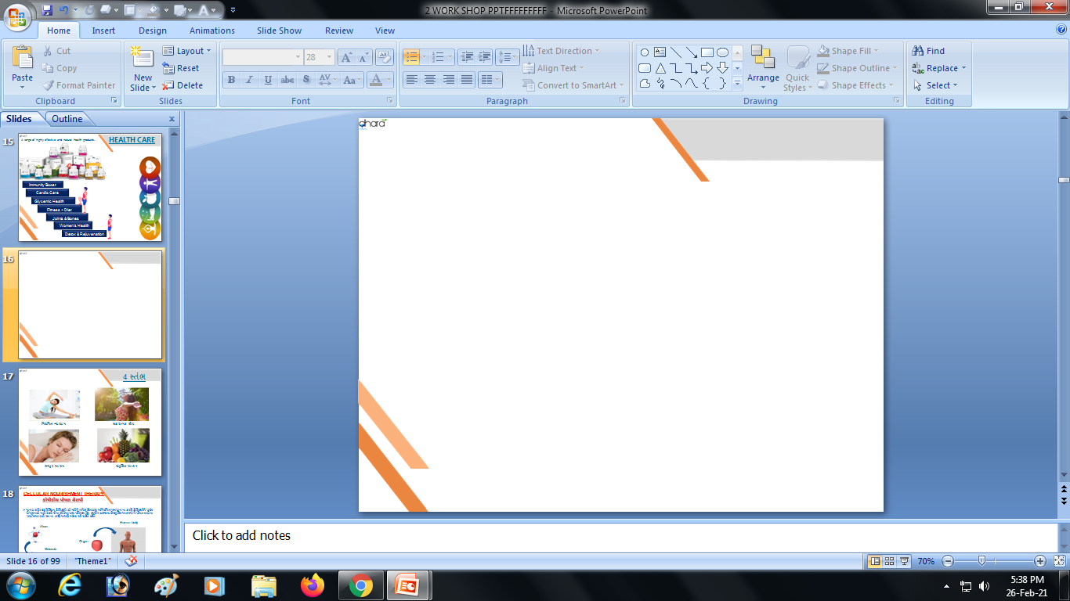

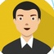
Plan के बाद .....ऐसे शुरू करवाए
Take Aadhaar card, Pan card, Mobile number, Bank Details
Download the app (VESTIGE / WINNING TEAM)
Give the address of the Vestige store
Set Home Meeting ( 1 week)
FAST START 8 %
3000 Rs
6000 Rs
10,000 Rs
Discount - 15 to 20 %
Free Product - 10 %
Bonus - 5 %
Discount - 15 to 20 %
Free Product - 10 %
Bonus - 5 %
Discount - 15 to 20 %
Free Product - 10 %
Bonus - 8 %
Free Product - 9 %
5 MONTH
5 MONTH
3000/- PRODUCT FREE
6000/- PRODUCT FREE
49 % BENIFIT

Slide 7

Business Builder
Business Kit
  Vestige Business Demo Kit – Winning Team Starter Kit, Presentation File and Brouchures
  Product Catalogue, Success Profile book,

Slide 8

Most important POINTS to hit The TARGET
NEED IDENTIFY
GOAL SETTING
GAME PLAN
CLOSING

Slide 9
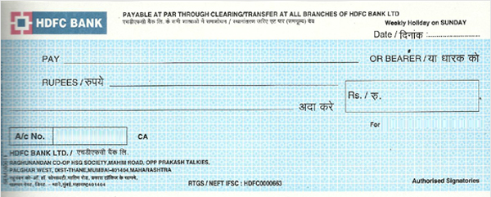
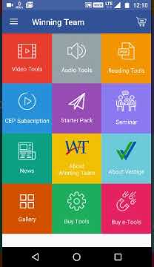
DESIGN YOUR CHEQUE

Slide 10
ZABBARDAST OFFER

Slide 11



NEED Only 2 thing

Slide 12


SUCCESSFUL
TEAM
SUCCESSFUL
YOU

Slide 13


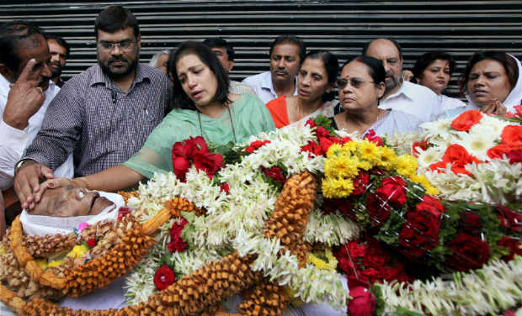


जीवन हमारा… रिजल्ट हमारा
खर्च
खास दोस्त
समाज
सर्कल
सोसायटी
मोबाइल संपर्क के साथी
सलाहकार
इनकम
YOU
लाइट बिल
दूध का बिल
अख़बार का बिल
किराने का सामान
घर का खर्च
किस्ते
पेट्रोल / डीजल
मनोरंजन खर्च
स्वास्थ्य खर्च
बीमा खर्च
सामाजिक खर्च
आकस्मिक खर्च
शैक्षिक खर्च
जब ज़िंदा था तब, कंधे का सहारा तो कोई हुआ नहीं,
अब यह मेरी अर्थि पर कंधे किसके है?

Slide 14




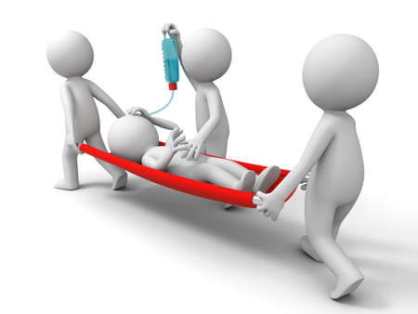


Objection handling
DIAMOND
CROWN
DUCD

